Slide 1
Welcome to My presentation

Slide 2
Topic :
“PRAN- RFL Group’s Expansion and Leadership in Manufacturing.”

Slide 3
Executive Summary
The PRAN-RFL Group's Managing Strategy and Change study offers a thorough examination of the strategic management techniques the company uses. With an emphasis on managing change, maintaining competitive advantage, and resolving important strategic concerns, the paper explores a number of PRAN-RFL Group's strategic objectives. The paper also examines PRAN-RFL Group's possibilities and challenges, with a focus on supply chain management, transformation, and change management. The report makes a significant contribution to the study of strategic management in the context of a well-known business by drawing on a wide range of sources to give readers a comprehensive understanding of PRAN-RFL Group's strategic management approach.

Slide 4
Introduction
PRAN began as a fruit and vegetable processor in Bangladesh in 1980, and after merging with RFL in 1981, it grew to become one of the country's largest corporate conglomerates. Among the millions of people in Bangladesh and the more than 145 countries where PRAN products are frequently exported, the PRAN group is today one of the most admired food and beverage brands.
Every product is made in accordance with international standards, guaranteeing the greatest degree of quality throughout the whole production process. PRAN is the first company in Bangladesh to engage in contract farming. The brand PRAN has made a name for itself in every sector of the food and beverage business, including dairy products, juices, carbonated drinks, snacks, confections, spices, and clothing.

Slide 5
Background of Pran-RFL Group
PRAN-RFL Group was founded in 17 march 1981 and started manufacturing in 1982 as a small trading company in Bangladesh by General (Ret) Amjad Khan Chowdhury. The company started its journey by importing agricultural commodities and later started manufacturing processed foods.
Today, PRAN RFL Group is one of the largest conglomerates in Bangladesh, operating in various industries, including agribusiness, plastics, household appliances, furniture, real estate, and many others. . They are now challenging the other multinational companies.

Slide 6
Vision
Improving Livelihood
The company aims to achieve this vision by leveraging its core strengths, including a strong brand reputation, a skilled workforce, and a diversified product portfolio.

Slide 7
Mission
The mission of PRAN-RFL Group is to be a market leader in each of its business sectors by providing innovative and high-quality products and services to customers.
The company's mission is also to create value for all stakeholders, including shareholders, customers, employees, and the communities in which it operates. PRAN-RFL Group aims to achieve its mission by investing in research and development, maintaining high standards of corporate governance, and promoting a culture of continuous improvement.

Slide 8
Core Values
PRAN-RFL believes in providing quality by considering the customers’ demands and expectation. Continuous innovation and improvement is the motive of the organization by focusing customers and tries to maintain fairness and transparency in all segments. The corporate values for PRAN-RFL are-
Consumer care
Suppliers care
Employee care
Trade care

Slide 9
Strategic and Structural Overview
Organizational Structure: Centralized, mechanistic framework with vertical command, control, and specialization across functions like production, marketing, and finance.
Core Competencies: Strong skills in product quality and design, supporting competitive market positioning.

Slide 10
Business Portfolio: Diverse industrial presence, including prefabricated steel structures and steel buildings.
Global Strategy: Focus on international expansion to drive growth.
HR Strategy: Structured human resource management aligning with strategic goals.

Slide 11
Porter’s Generic Strategies
Diversification: PRAN group has diversified its operations across multiple industries to reduce its dependence on any single industry or product category.
Geographic Expansion: PRAN group has expanded its operations beyond Bangladesh and has established a presence in many international markets.

Slide 12
Leadership Role in Manufacturing sector:
Cost Leadership
Differentiation
Growth Strategy
Marketing Strategies

Slide 13

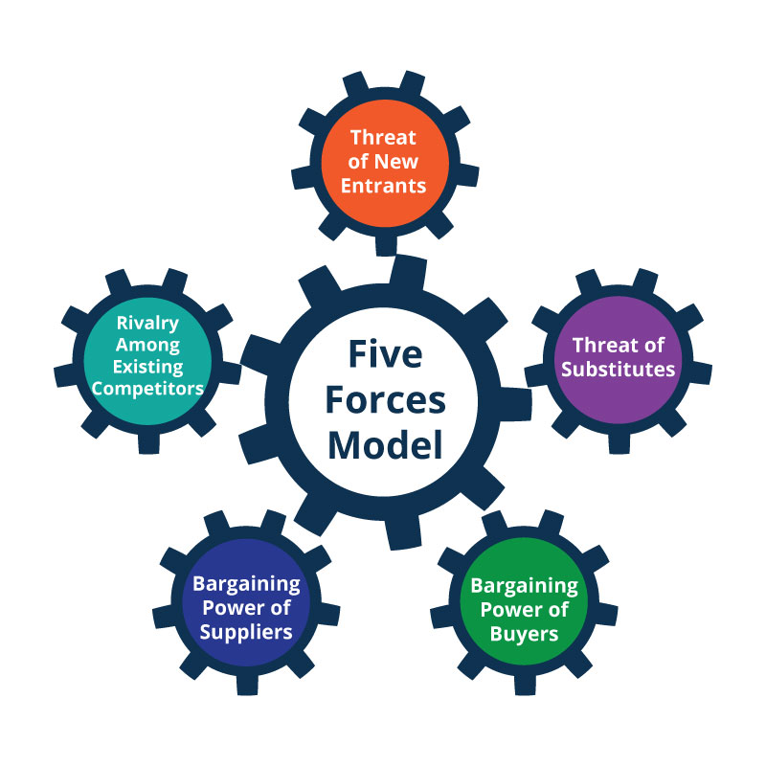
Pran-RFL's Strategic Insights Through Porter's Five Forces

Slide 14
BCG (Boston Consulting Group) Matrix
Applying the BCG matrix to the company's products and services can help to identify its growth potential and determine which products to invest in or divest from. The BCG matrix is a tool used to analyze a company's product portfolio and identify which products should receive more or less investment based on their market growth rate and market share.
The matrix categorizes products into four categories:
Stars: Products with a high market share in a high growth market.
Cash Cows: Products with a high market share in a low-growth market.
Question Marks: Products with a low market share in a high-growth market.
Dogs: Products with a low market share in a low growth market.

Slide 15
Conclusion
PRAN group rapidly reaches the success by diversifying their products and promotes their products in home and abroad. They want to reach the peak of customer satisfaction. PRAN group's business-level strategies have helped the company to achieve its mission of becoming a world-class brand. The company's focus on product differentiation, cost leadership, market segmentation, diversification, and geographic expansion has enabled it to capture new market opportunities, reduce risks, and meet the changing needs of its customers. Finally, we can say that, PRAN-RFL Group has demonstrated strong growth and market leadership over the years, and with a focus on strategic planning and implementation of these recommendations, it is poised to continue its success and growth trajectory in the future.

Slide 16
Thank You

